Slide 1
Constraint-Based Dynamic Energy Management in Energy Harvesting Embedded System WeiYing Yi 1155026053 Department of Computer Science and Engineering Faculty of Engineering The Chinese University of Hong Kong

Slide 2
Core Idea
Core Idea Assumptions Issues More Improvements? Conclusions
■ ■ ■ ■ ■ ■ ■ ■ ■ ■ ■ ■
Reference Paper
S. O´ . Murphy, O´ . Manzano, and K. Brown, “Design and evaluation of a constraint-based energy saving and scheduling recommender system,” in Principles and Practice of Constraint Programming, ser. Lecture Notes in Computer Science, G. Pesant, Ed. Springer International Publishing, 2015, vol. 9255, pp. 687–703. [Online]. Available: http://dx.doi.org/10.1007/978-3-319-23219-5 47
Saving energy while keeping good enough performance of the system (home appliances)
Adapted the idea into embedded systems powered by renewable energy
Example: wireless sensing node with small solar cell and small battery

Slide 3
Assumption
Core Idea Assumptions Issues More Improvements? Conclusions
■ ■ ■ ■ ■ ■ ■ ■ ■ ■ ■ ■
Convert continuous time t to discrete intervals T
10 mins per interval, 144 intervals per day
Solar energy prediction function F(T) with 100% accuracy
Sensor node consists of 7 sensors and 1 radio link
Experiment data are self-define
Definition:
Wasted Energy: not used by any of the 8 devices
Endurance: # of intervals with non-zero energy consumption
Data quality: evenly distribute the sampling tasks

Slide 4
Issues
Core Idea Assumptions Issues More Improvements? Conclusions
■ ■ ■ ■ ■ ■ ■ ■ ■ ■ ■ ■
Nature of solar energy => Unstable
Not power line as the reference paper
Battery capacity => Limited
Small battery for embedded system
Charging efficiency => < 100%
Usually 80%

Slide 5
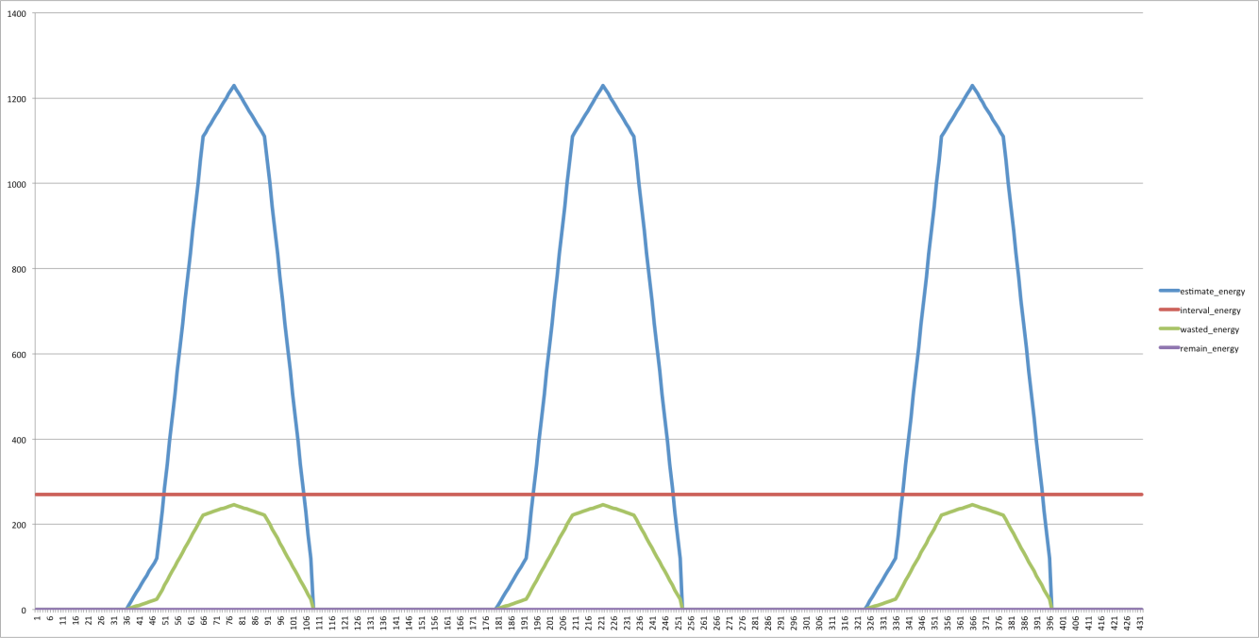
Issues: Unstable Solar Energy
Core Idea Assumptions Issues More Improvements? Conclusions
■ ■ ■ ■ ■ ■ ■ ■ ■ ■ ■ ■
Solar energy => Battery => Static DC power(averaging interval energy consumption)
Maximal system endurance
Require large enough battery capacity
Approach | Wasted Energy | Endurance/144
1 | 70.83 | 144
2
3
4
5
6

Slide 6
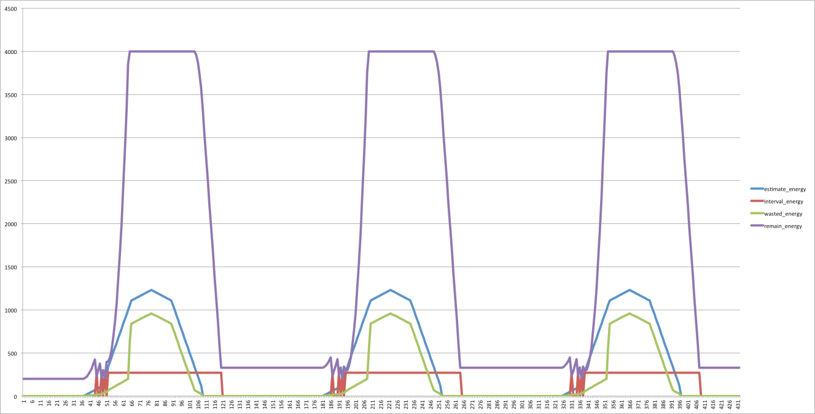
Issues: Limited Battery Capacity
Core Idea Assumptions Issues More Improvements? Conclusions
■ ■ ■ ■ ■ ■ ■ ■ ■ ■ ■ ■
Solar energy => Battery => Static DC power (averaging interval energy consumption)
Energy wasted when battery is full
Approach | Wasted Energy | Endurance/144
1 | 70.83 | 144
2 | 216.42 | 73
3
4
5
6

Slide 7
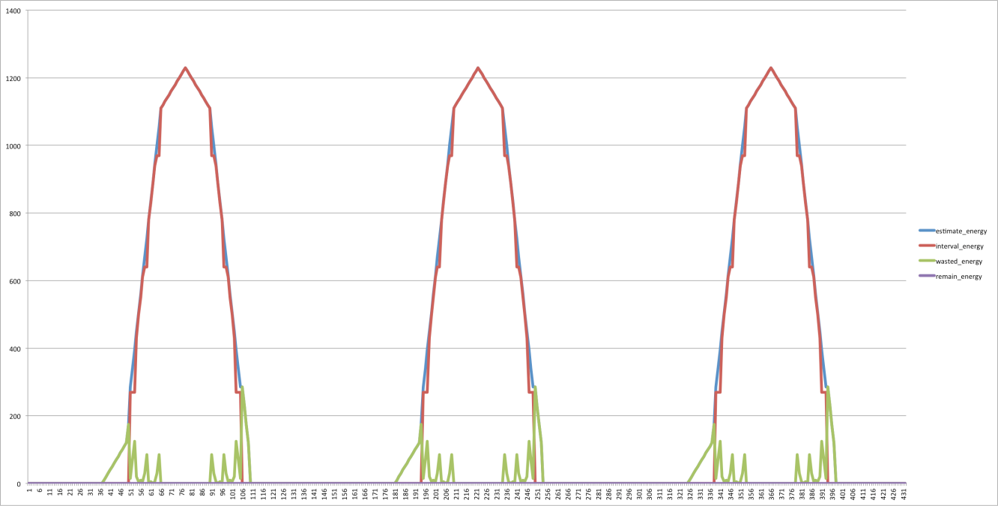
Issues: Charging Efficiency < 100%
Core Idea Assumptions Issues More Improvements? Conclusions
■ ■ ■ ■ ■ ■ ■ ■ ■ ■ ■ ■
Solar energy => Sensor node
No battery => No energy wasted for charging
Energy consumption of sensor node adapts to solar energy
Approach | Wasted Energy | Endurance/144
1 | 70.83 | 144
2 | 216.42 | 73
3 | 19.6 | 55
4
5
6

Slide 8
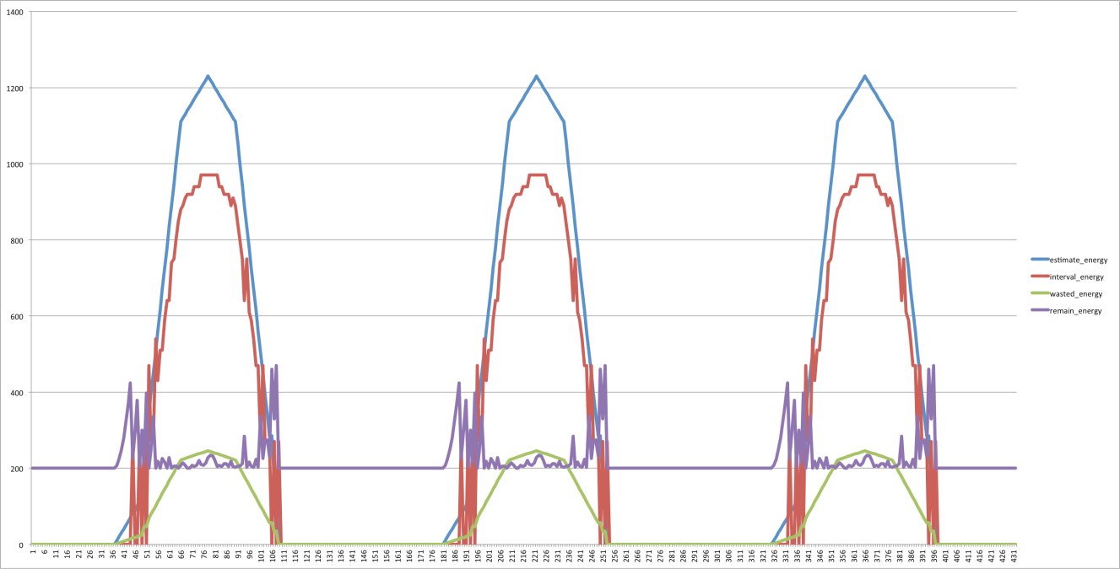
Issues: Endurance Too Low
Core Idea Assumptions Issues More Improvements? Conclusions
■ ■ ■ ■ ■ ■ ■ ■ ■ ■ ■ ■
Solar energy => Battery => Sensor node
Energy consumption of sensor node adapts to solar energy
Energy wasted as charging efficiency < 100%
Approach | Wasted Energy | Endurance/144
1 | 70.83 | 144
2 | 216.42 | 73
3 | 19.6 | 55
4 | 70.69 | 59
5
6

Slide 9
More Improvement?
Core Idea Assumptions Issues More Improvements? Conclusions
■ ■ ■ ■ ■ ■ ■ ■ ■ ■ ■ ■
We want less wasted energy
We want larger endurance
Why you are so greedy?

Slide 10
More Improvement?
Core Idea Assumptions Issues More Improvements? Conclusions
■ ■ ■ ■ ■ ■ ■ ■ ■ ■ ■ ■
We want less wasted energy
Reduce the solar energy stored into battery
Energy consumption of the sensor node adapts to the solar energy
We want larger endurance
Take the future into account

Slide 11
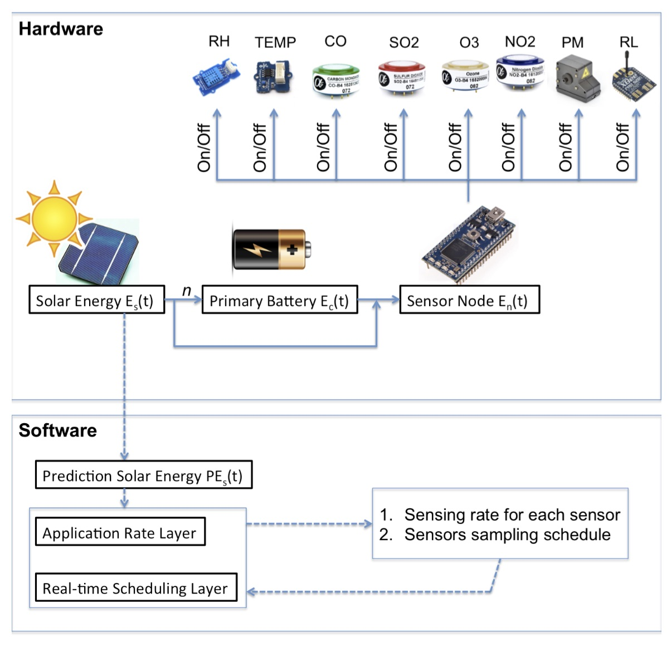
More Improvement?
Core Idea Assumptions Issues More Improvements? Conclusions
■ ■ ■ ■ ■ ■ ■ ■ ■ ■ ■ ■
Proposed system
Hardware
Sensor node can access the
harvest energy directly
Or access energy stored in energy
Software
Application Rate Layer
Real-time Scheduling Layer

Slide 12
More Improvement?
Core Idea Assumptions Issues More Improvements? Conclusions
■ ■ ■ ■ ■ ■ ■ ■ ■ ■ ■ ■
Application Rate Layer
COP
Objective: Find the optimal operational rate for each interval of each devices of the sensor node, such that the wasted energy is minimized while have good enough endurance
Assign each type of data a reward value, i.e. reward_CO = 10, reward_RH = 5
Achieved by maximized the total rewards of the next K intervals while satisfying energy constraint

Slide 13
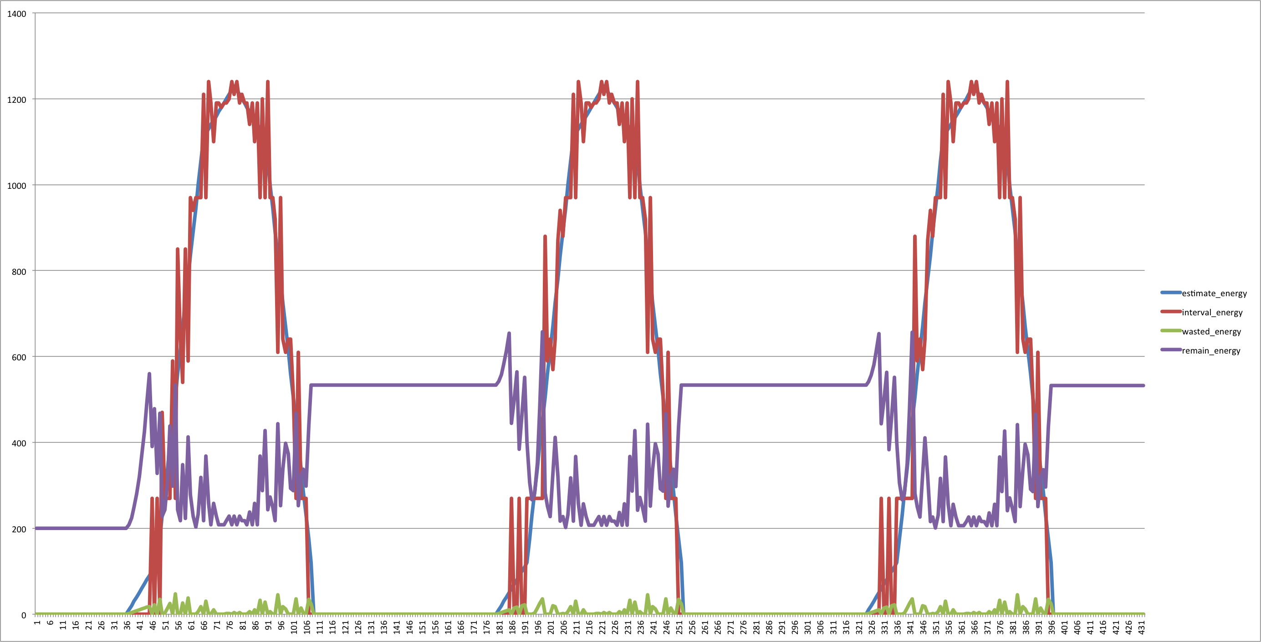
More Improvement?
Core Idea Assumptions Issues More Improvements? Conclusions
■ ■ ■ ■ ■ ■ ■ ■ ■ ■ ■ ■
Application Rate Layer with K = 3
Significant improvement in wasted energy
Improvement in endurance
Approach | Wasted Energy | Endurance/144
1 | 70.83 | 144
2 | 216.42 | 73
3 | 19.6 | 55
4 | 70.69 | 59
5 | 4.09 | 61
6

Slide 14
More Improvement?
Core Idea Assumptions Issues More Improvements? Conclusions
■ ■ ■ ■ ■ ■ ■ ■ ■ ■ ■ ■
Application Rate Layer with K = 6
Improvement in endurance at the expense of slight incensement of wasted energy
Approach | Wasted Energy | Endurance/144
1 | 70.83 | 144
2 | 216.42 | 73
3 | 19.6 | 55
4 | 70.69 | 59
5 | 4.09 | 61
6 | 4.41 | 62

Slide 15
More Improvement?
Core Idea Assumptions Issues More Improvements? Conclusions
■ ■ ■ ■ ■ ■ ■ ■ ■ ■ ■ ■
Real-time Scheduling Layer
Input is from the Application Rate Layer
i.e. optimal operation rate {6, 6, 6, 6, 5, 1, 1, 2} in 10 minutes interval
Divided the 10 minutes interval into 10 smaller intervals, each small interval is 1 minute
Objective: We want to have good data quality of each type of sensors.
Achieved by evenly distributed the samples in the 10 one minute intervals
CO: {1, 1, 0, 1, 0, 1, 0, 1, 0, 1}
SO2: {1, 1, 0, 1, 0, 1, 0, 1, 0, 1}
O3: {1, 1, 0, 1, 0, 1, 0, 1, 0, 1}
NO2: {1, 1, 0, 1, 0, 1, 0, 1, 0, 1}
PM: {1, 1, 0, 1, 0, 1, 0, 1, 0, 1}
TEMP: {0, 1, 0, 1, 0, 1, 0, 1, 0, 1}
RH: {0, 0, 1, 0, 0, 0, 0, 0, 0, 0}

Slide 16
Conclusions
Core Idea Assumptions Issues More Improvements? Conclusions
■ ■ ■ ■ ■
Our approach is able to:
Fully utilized the harvested energy
Improvement in reduce the amount of wasted energy
Improvement in increase the endurance
Sufficient good data quality with given operational rates of all devices

Slide 17
Thank you!

